Slide 1
#GET READY 4
FUTURE!

Slide 2
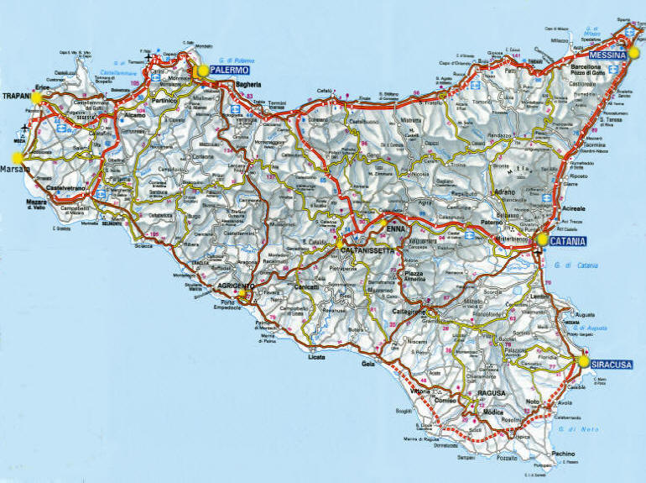
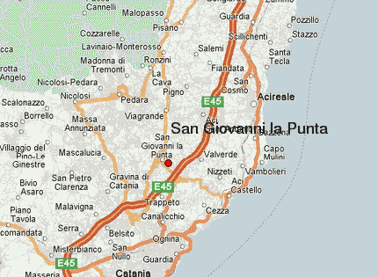
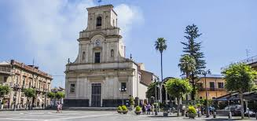
COMPREHENSIVE SCHOOL
“CARLO ALBERTO DALLA CHIESA”
SAN GIOVANNI LA PUNTA (CT) , ITALIA
San Giovanni la Punta is a small town in the Province of Catania in the Italian region of Sicily, located about 160 kilometers (99 mt) southeast of Palermo and about 8 kilometers (5 mt) northeast of Catania.
It has a population of about 22.185 inhabitants.

Slide 3
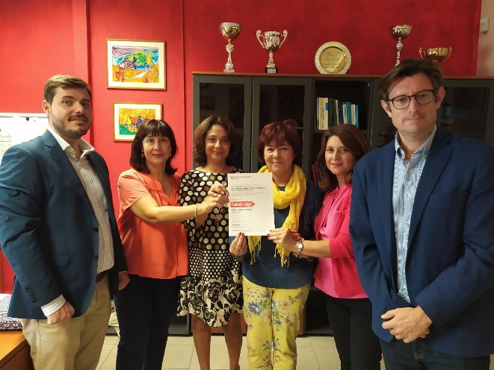
PRIMARY AND SECONDARY SCHOOL
In our school there are four buildings: primary, secondary school, and kindergarten. It has 1030 students, aged 3 to 13 and about 90 teachers. Students learn English since they attend kindergarden and English and French in primary and secondary school. They use the language laboratory to learn. Every year the school is awarded by Cambridge for the students exams result. School offers many activities in the morning and, if students want, there are different extra curriculum in the afternoon to improve their knowledge and skills .
There is a gym, a science, computer and art lab!

Slide 4
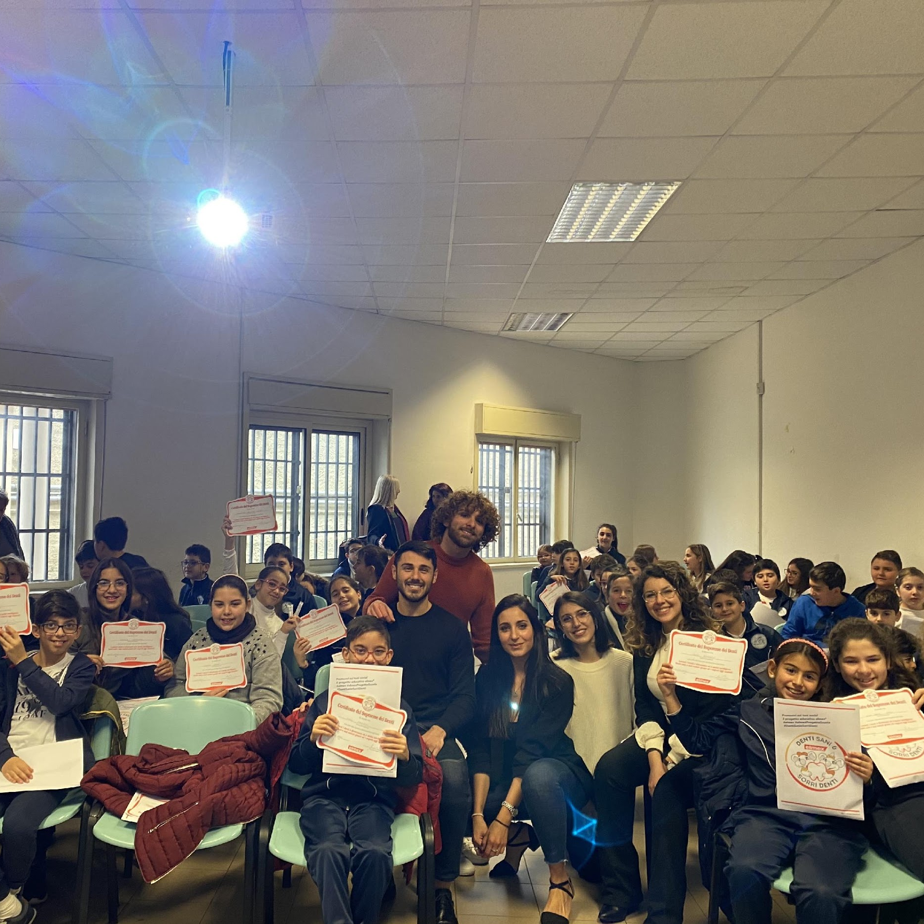
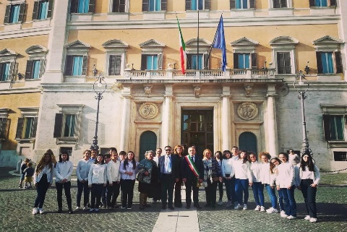
SCHOOL’S ACTIVITIES!
Students play different sports
Important projects such as legality, solidarity and human rights
Science Lab
Conference about health
Join new project

Slide 5
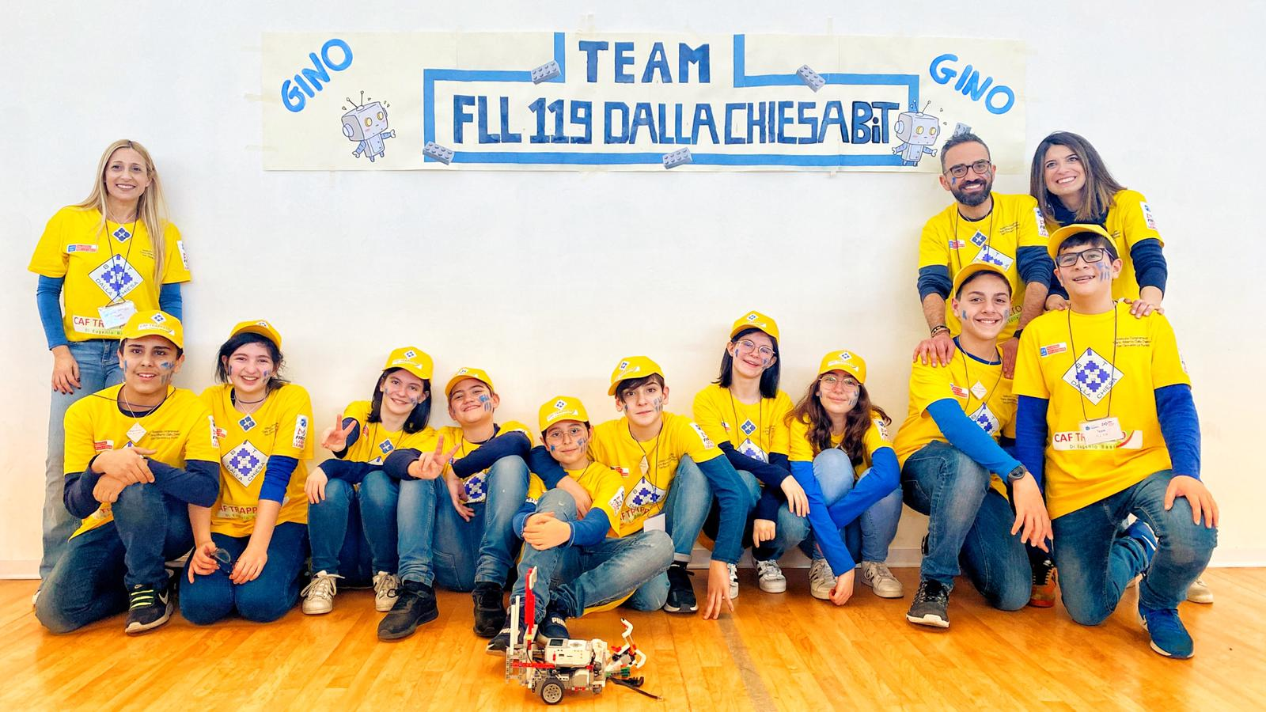
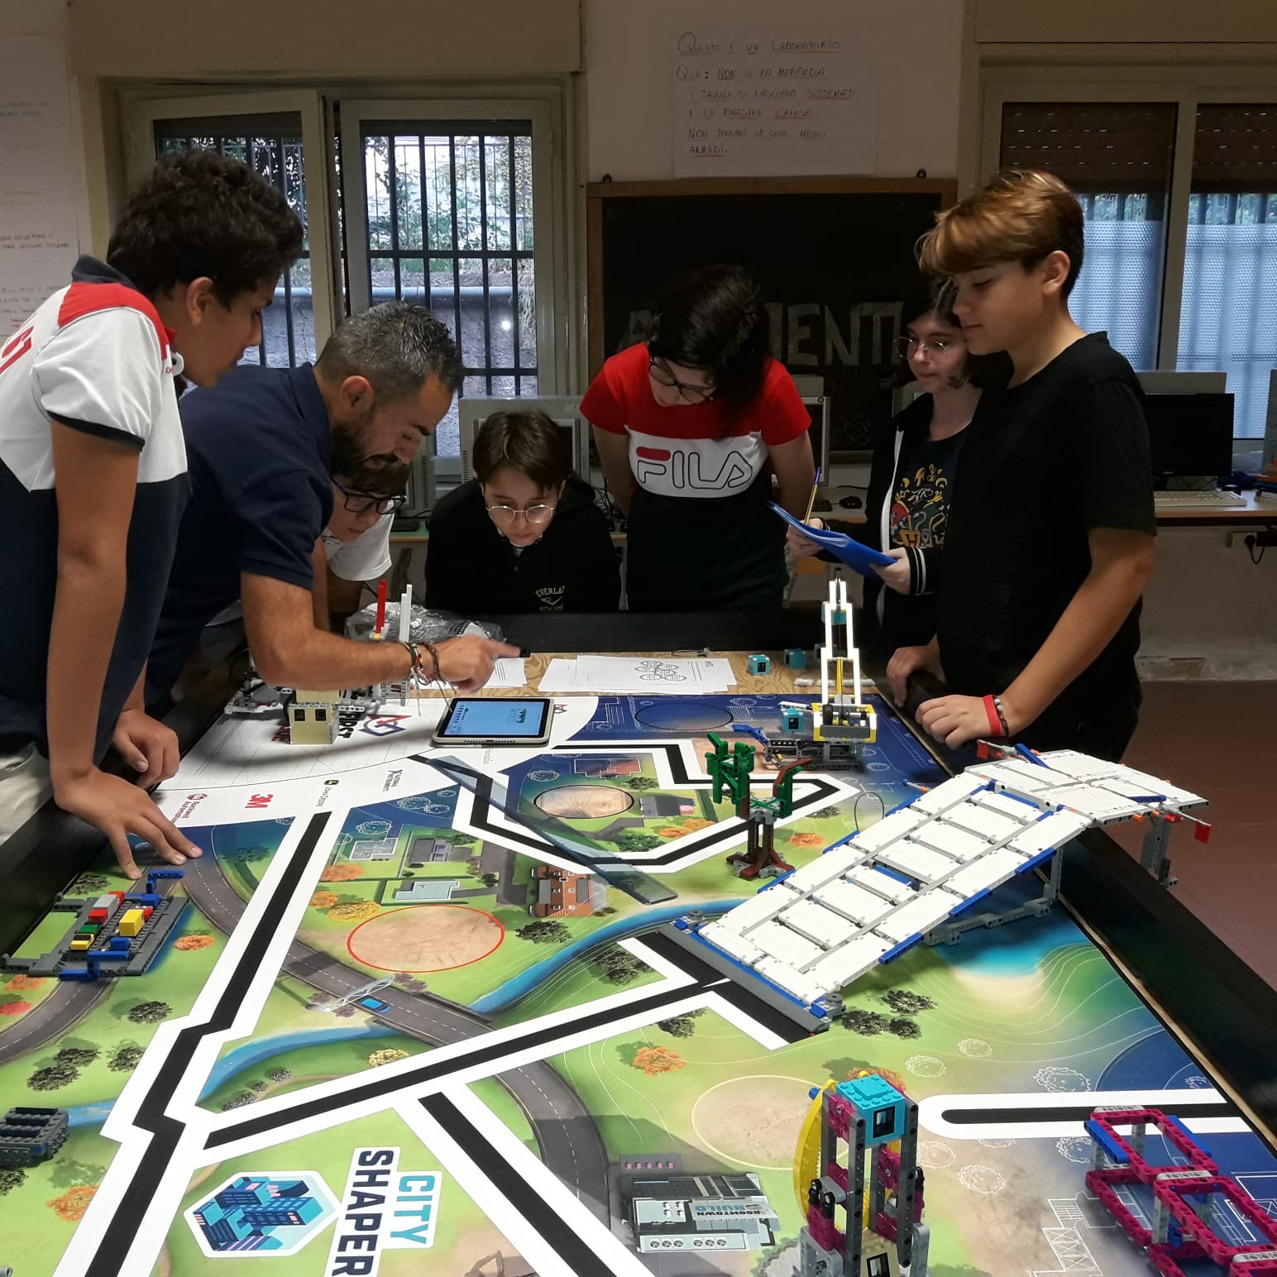
Last year our school joined
“ The First Lego League”
Thanks to the project students had the opportunity to develop skills and abilities on this topic.

Slide 6
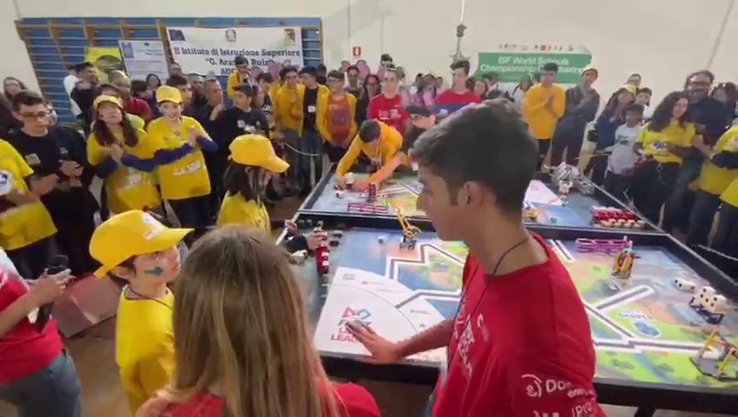
Put your great subtitle here

Slide 7
THANK YOU!

